Slide 1
“Gloriously straightforward”:
Removing barriers to resource discovery
Suzanne Tatham, Academic Services Manager
Chris Keene, Technical Development Manager

Slide 2
Background
Push from students
Complaints from academics
NSS - “not enough copies of core texts”

Slide 3
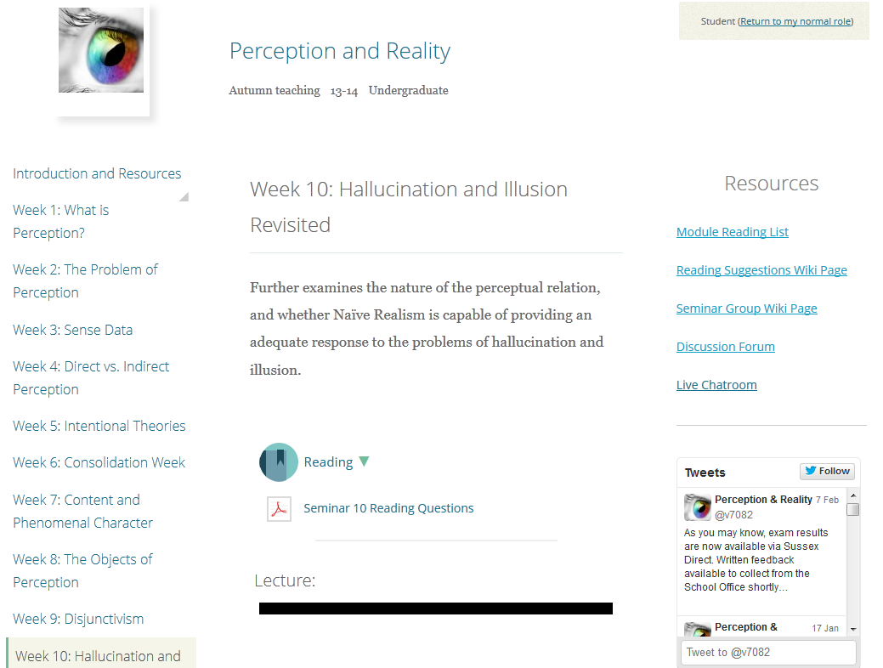

Slide 5
Issues: students use other systems
Students and academics saw Reading lists as a separate system
Students use Study Direct (Moodle) and Module Handbooks for information
Needed a fully integrated approach (at least for students) to hide separate system

Slide 6
Study direct
Moodle
Small team in IT Services
Very strong focus on student/tutor feedback and needs.
Regular user testing and monitoring to discovery pain points and confusion.
http://blogs.sussex.ac.uk/elearningteam/

Slide 7
Study Direct
Led to the removal of blocks, boxes and Moodle modules down the side of the screen. Students found them confusing. Found no one was using them.
This included previous library block which included a basic link to the reading list.

Slide 8
Process
Sat round table with e-learning team. Set context, explain reasons.
Made it clear it was something students and staff had raised, not a library pet project. Plus other benefits of increased use of reading list system such as acquisition of relevant materials.

Slide 9
Process
After much discussion…
…core code developed quickly by e-learning team.
Some tricky bits to think about around the roll over of both Moodle modules and Aspire lists, and allowing users to access historical information.
Testing, and then live summer 2013.
http://vimeo.com/61188252

Slide 10
Workflow: tutors add a resource

Slide 11
Workflow: pick a section

Slide 12
Workflow: give it a title

Slide 13
Behind the scenes
Study Direct
Aspire
Study direct asks for the html for the list (just like a web browser)
Aspire sends html back
No APIs used (didn’t provide information required)
Use Aspires ‘nice urls’ which include the module code and year.

Slide 14
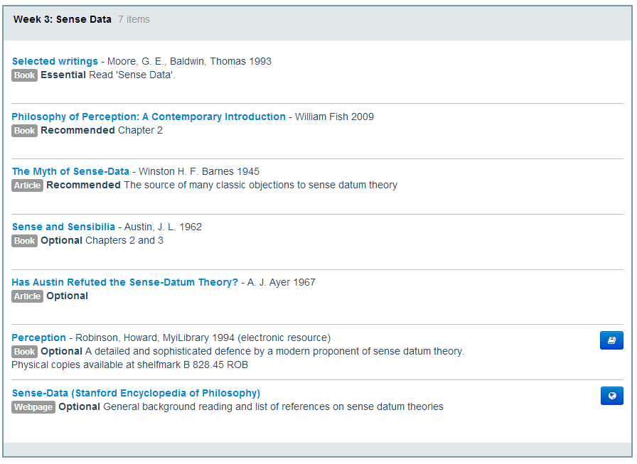

Slide 16
Student feedback
Interviews held with History, Philosophy, Psychology and Sociology undergraduate students
Asked about their use of their online reading lists and the choices they make about what to read

Slide 17
How have you found the integrated online reading list?

Slide 18
Do you think having your list integrated within the VLE has made it easier to access the items on the list?

Slide 19
How useful do you find it being able to link through directly to the item on the list, including print books in the Library?

Slide 20
What influences your decision on which item you choose to read?

Slide 21
Do you use ebooks often?

Slide 22
Do you feel that having an online reading list makes any difference to you to how you approach your reading?

Slide 23
How are we measuring success?
Interviews with academics and students
Google analytics to get page views – adding student numbers
Looking for knock-on effect on print use
http://en.wikipedia.org/wiki/File:MeasuringSpoons.jpg

Slide 24
Increased use of resources
So far, only 7% of reading lists have been integrated into the VLE but 35% of the top 100 items viewed are on an integrated list

Slide 26
Average views per item (top 100 items)

Slide 27
Feedback from academics
Learning Technologist, Dr Anne Hole, carried out a series of interviews with academics.
Benefits of integration from academics’ points of view:
Very easy to embed sections of the reading list into the VLE
Section-by-section integration increases students’ engagement with the reading
It keeps all resources for the module in one place
Increased accessibility of online resources
Requires time investment but off-set by student benefit – they’re likely to do more reading

Slide 28
“Some colleagues are a little apprehensive that providing clickable links to readings is making it too easy for students and risks failing to develop their research and library skills. On the other hand, removing obstacles to finding readings for increasingly time-poor students has the potential to increase the amount of reading that they can do.”
https://rustleblog.wordpress.com/2014/01/13/putting-reading-at-the-heart-of-study-direct/

Slide 29
Student engagement
If lists are used and updated in a dynamic way, do students get an insight into scholarly communication?
“He’s bothered to engage with you and you feel you’re more part of an academic dialogue. He’s building the course and it’s still an area that’s of interest to him.”

Slide 30
Spoon-feeding?
Do you agree with the argument that locating items on a reading list is an academic skill that students should learn?

