Slide 1
Zotero 5.0 and Juris-M: Reference Management for Law

Slide 2
Today’s session
Zotero+Juris-M: what they are and how they work
Getting Started: downloading and syncing Zotero+Juris-M
Adding items to your Juris-M Library
1. Downloading and importing records from Primo & Desktop
2. Using the Juris-M connector to capture web resources
3. Manually adding items from Lexis and Westlaw
Juris-M Library functionality: attachments, notes and folders
Adding citations to word with Zotero plugin
Further support

Slide 3
Zotero and Juris-M
“Zotero is a free, open-source research tool that helps you to collect, organise, and analyze research and share it in a variety of ways” www.zotero.org/about/
Zotero recommend using Juris-M for legal citations: www.zotero.org/support/kb/legal_citations
Juris-M is a variant of Zotero that adds support for legal writing. It was developed by Frank Bennett, Associate Professor of Law at Nagoya University.

Slide 4
How it all works
Sync your accounts;
invite members
to your Groups
Zotero
Push to Word in desired style e.g. OSCOLA
Juris-M
Push to Word in desired style e.g. JM OSCOLA
Pull bibliographic info from items on web or desktop
create folders, add notes etc.
+ add records manually
Juris-M Connector
Zotero Plug-in
Item you’re using
Report you’re writing
Your ‘Library’

Slide 5
Getting started - step 1: Download Zotero 5.0 for Windows

Slide 6
Download
Zotero for Windows,
and add plugin for Word if needed (should be installed automatically with version 5.0)
www.zotero.org/download/

Slide 7
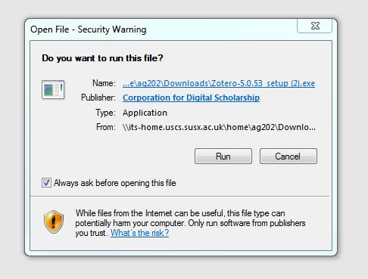
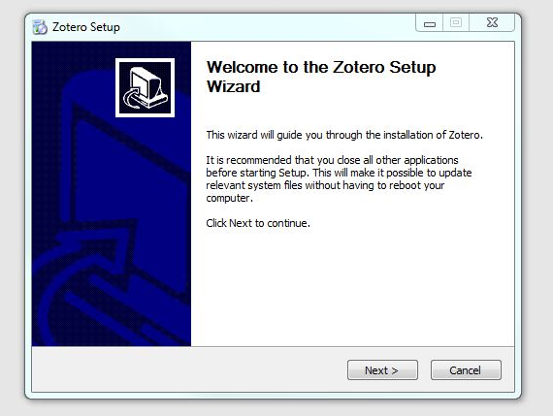
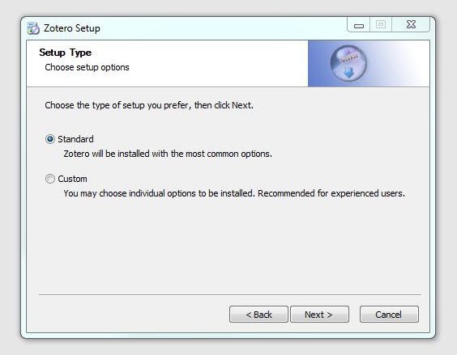
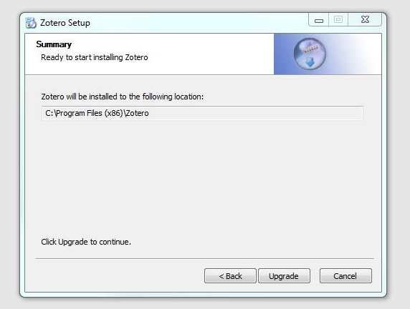
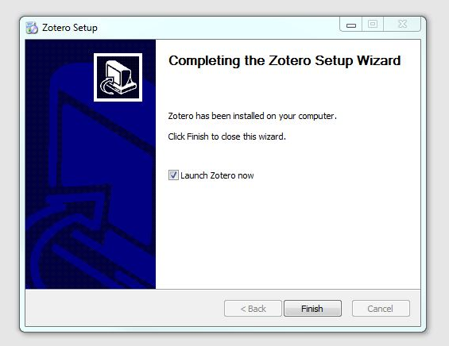
Download Zotero 5.0 for Windows

Slide 8
Getting started - step 2: Download Juris-M Standalone and Browser Connector

Slide 9
Go to https://juris-m.github.io/downloads/
and download Juris-M for Windows (latest release),
and Browser Connector e.g. Google Chrome (plugin installer)
1
1
2

Slide 10
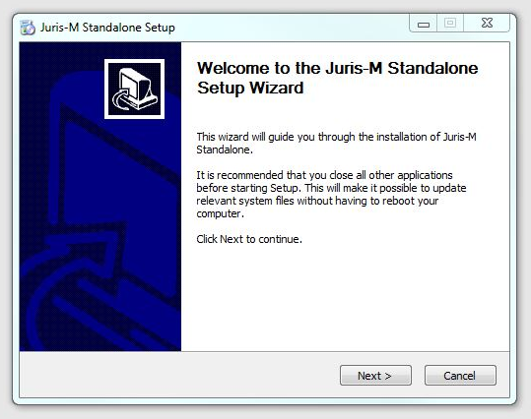
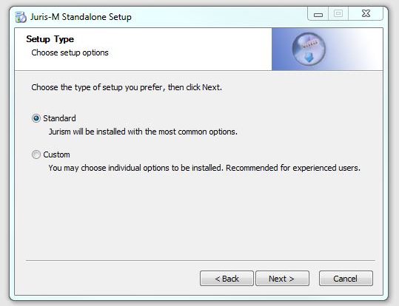
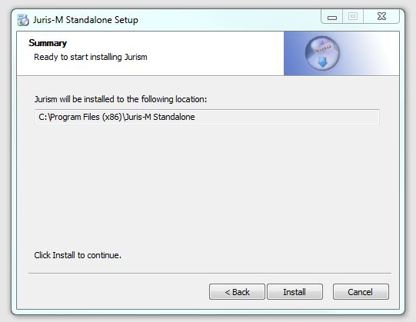
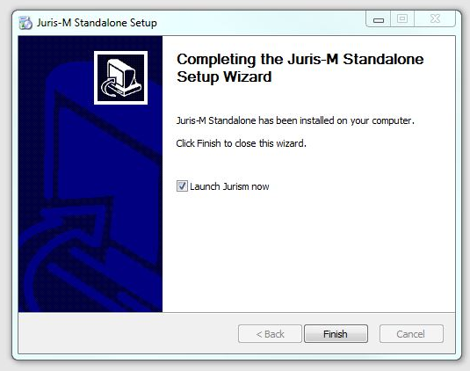
1. Download Juris-M Standalone for Windows

Slide 11
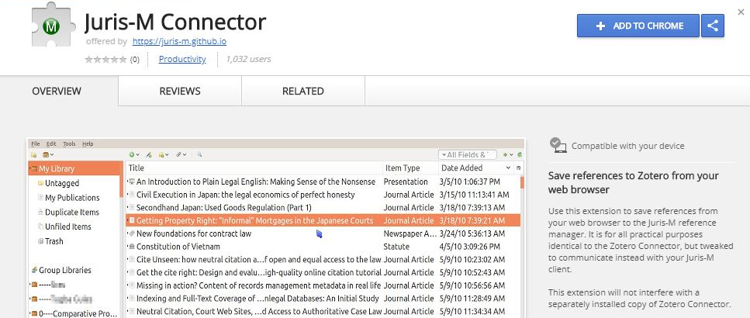
2. Download and add Juris-M
Browser Connector

Slide 12
Getting started - step 3: Sync Zotero and Juris-M

Slide 13
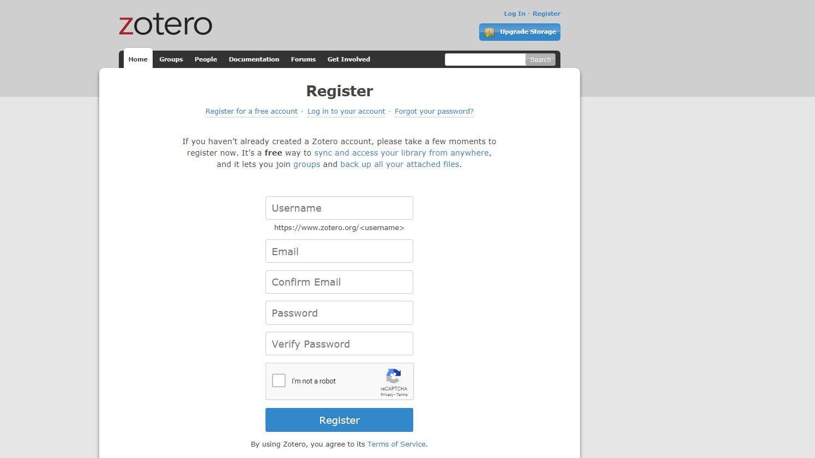
Register with Zotero to enable syncing (and to join groups)
www.zotero.org/user/register

Slide 14
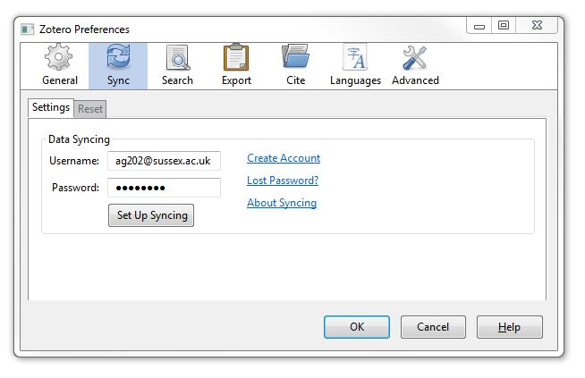
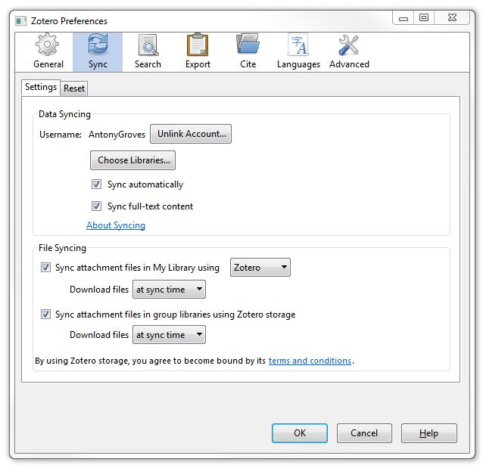
1. Open Juris-M standalone from your desktop.
2. In Juris-M click on Edit and Preferences.
3
3. Enter Username and Password
and click Set Up Syncing.
4. Click OK on next pop-up.
1
4

Slide 15
1. Adding items from Primo to your Juris-M Library via the Desktop: Downloading + Importing RIS files

Slide 16
Click on the title of item you wish to use. On the details page you will find referencing options. Click on RIS:ZOTERO/ENDNOTE and then on DOWNLOAD. Save the downloaded RIS file to your desktop.

Slide 17
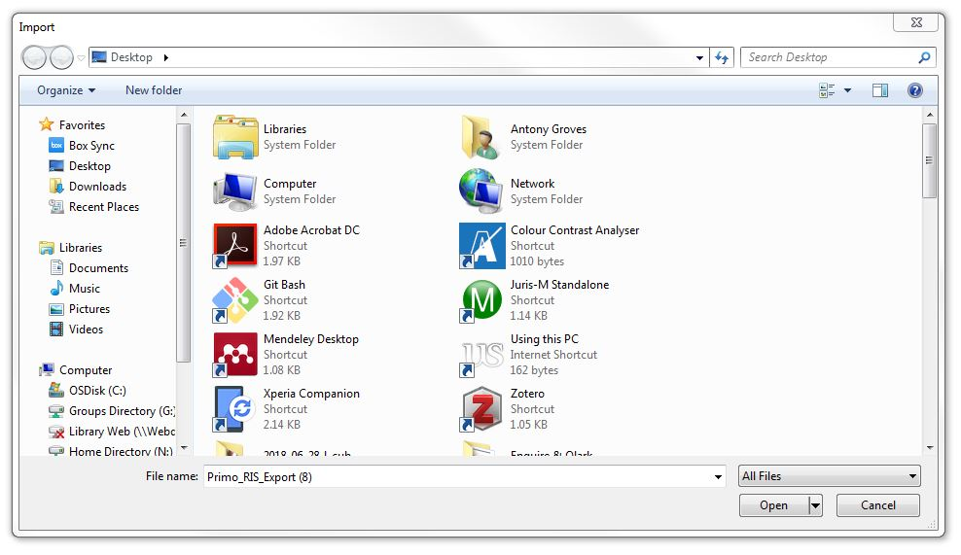
1. Open Juris-M standalone
from your desktop.
2. In Juris-M click on File
and Import.
3. Follow the prompts
answering that you want
to import from A file.
4. Select the RIS file from
your desktop, click Open,
then Next, then Finish.
*if importing a PDF, right click to ‘Retrieve Metadata for PDF’
1
4

Slide 18
2. Adding items to your library using the Juris-M connector to capture web resources

Slide 19
The Juris-M browser extension can automatically recognise what it is looking at e.g. a webpage, journal article, or case (sometimes). The accompanying icon will change accordingly. Click on the icon to automatically save the item to your Juris-M library.

Slide 20
3. Adding items to your library manually in Juris-M

Slide 21
Unfortunately because of the way that some Law databases operate, items have to be added manually to your Juris-M library.
1. In Juris-M click on File
and New Item.
2. Select the type of item that
you wish to add e.g.
Case or Statute.
1
4

Slide 22
3. Add the relevant information
to the record by completing
the form on the right side of
the page – simply click in the
field that you need to edit.
4. The tabs along the top give
extra functionality and allow
you to add notes about this
item, create tags, and link
related items from your library.
1
4

Slide 23
5. It is also possible to attach the related PDF to the record by clicking on the paperclip icon. This will give you several options. If you have the PDF on your computer, you will be able to attach it by selecting Attach Stored Copy of File, which will allow you to select a file from your desktop (or other location).

Slide 24
Juris-M Library functionality: collections, notes, tags and related

Slide 25
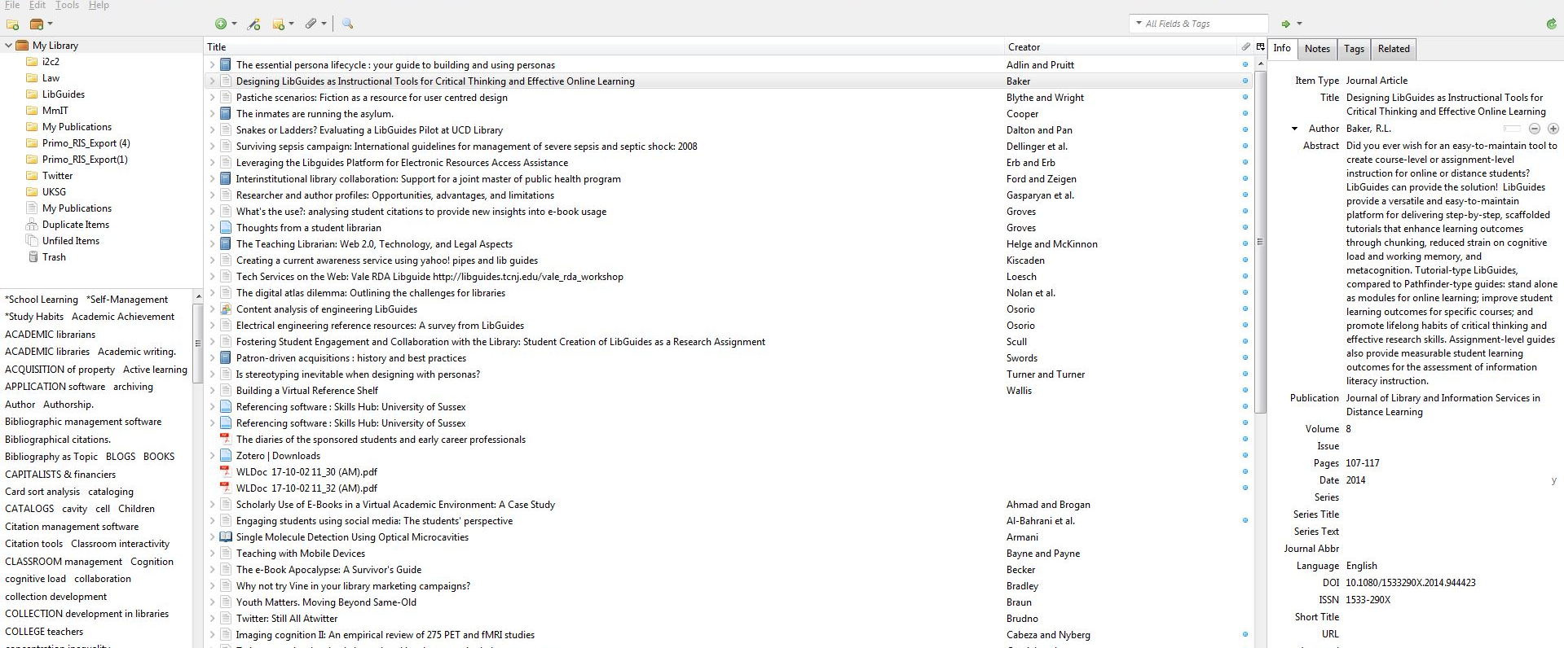
Open Juris-M Standalone to access your Juris-M library. You can create collections, add tags and make notes to help manage what you find. Drag and drop items into folders.

Slide 26
Adding citations to your Word document

Slide 27
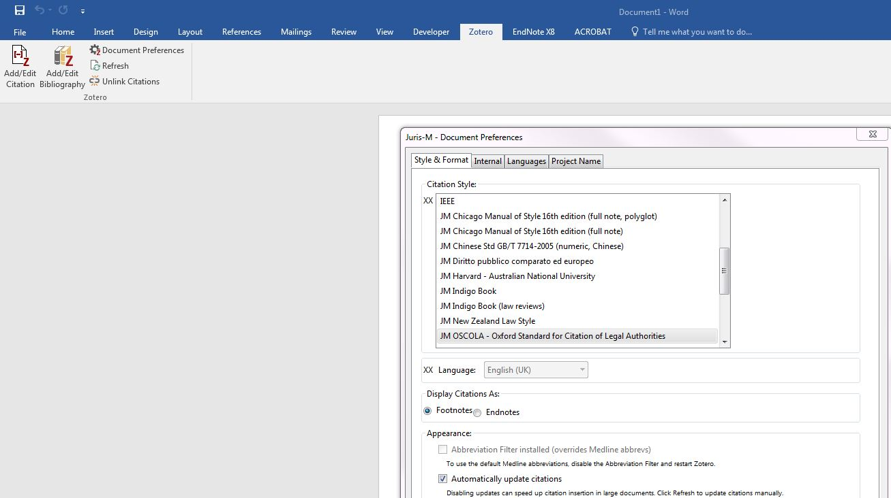
The plugin for Word will allow you to add individual citations from your Juris-M library, and automatically generate bibliographies from these citations. Document Preferences will allow you to select the appropriate style.

Slide 28
Demo: automatically adding citations to Word from your Juris-M Library

Slide 29
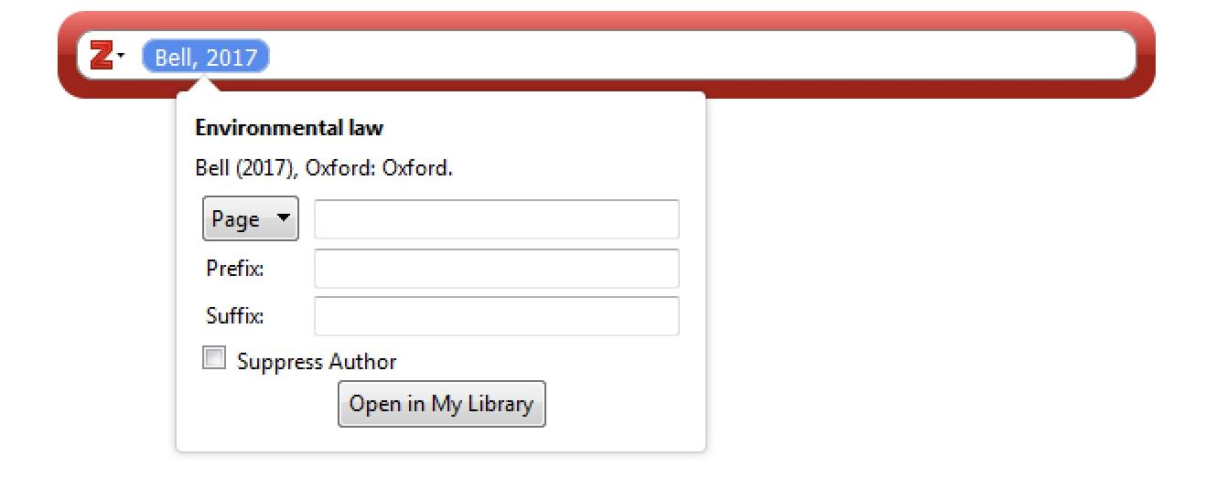
Adding pinpoints to your citation
In Word, under the Zotero tab, click on ‘Add/Edit citation’
Use the pop-up search bar to find the item from your Library
Click on the citation to get pinpointing options
Choose the ‘locator’ (page, paragraph etc.) from the dropdown and add corresponding information e.g. page no.

Slide 30
Further Support
Juris-M documentation: https://media.readthedocs.org/pdf/juris-m/latest/juris-m.pdf
Zotero documentation (including ‘Zotero for Mobile’): https://www.zotero.org/support/
Zotero forum: https://forums.zotero.org/discussions

