Slide 1
Writing and Writing Back: The Transcultural Oeuvres of Sir Richard Burton, T.E. Lawrence and Kahlil Gibran
Dr Feras Alkabani
University of Sussex

Slide 2
Lecture Structure
Travel Writing: A Worldwide Tradition
Orientalism: curiosity, fantasy and imperialism
The Arab Nahda (Renaissance/Revival): Writing back
Transcultural Writers: Sir Richard Burton, T.E. Lawrence and Khalil Gibran
Culture: a universal, human enterprise

Slide 3
Travel Writing
Travel writing is a universal phenomenon
To travel is to transgress political, geographical and cultural boundaries; thus to write (and to consume writing) is also an act of transgression
To write about the ‘Other’ is to compare: it is to write about the ‘Self’ vis-à-vis the ‘Other’.
Transcultural writing is not just an act of representation; it is an act of mediation between ‘otherness’ and ‘familiarity’ – an attempt at interpretation
A transcultural writer is a cultural mediator and interpreter

Slide 4
Worldwide Tradition
Orientalist literature features as a prominent example of travel writing
However, travel writing is a worldwide tradition that traverses time and space
Ibn Jubayr (1145-1214) and Ibn Battuta (1304-1377) are two medieval Arab travel writers
Like their Orientalist counterparts, they were attracted to the ‘exotic’ and the ‘weird and wonderful’
Ibn Battuta’s al-Rihla (The Journey) documents his 30 years of extensive travel; his accounts were comparative and not judgement-free.

Slide 5
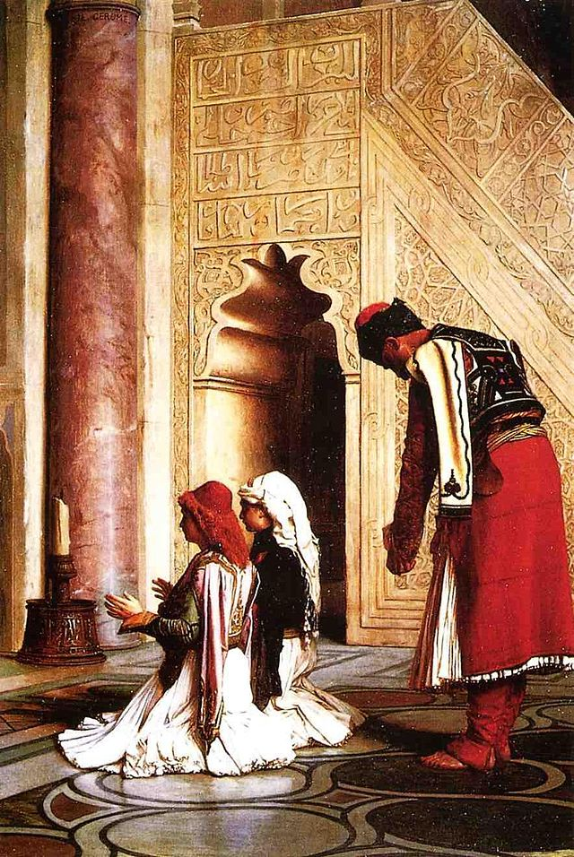
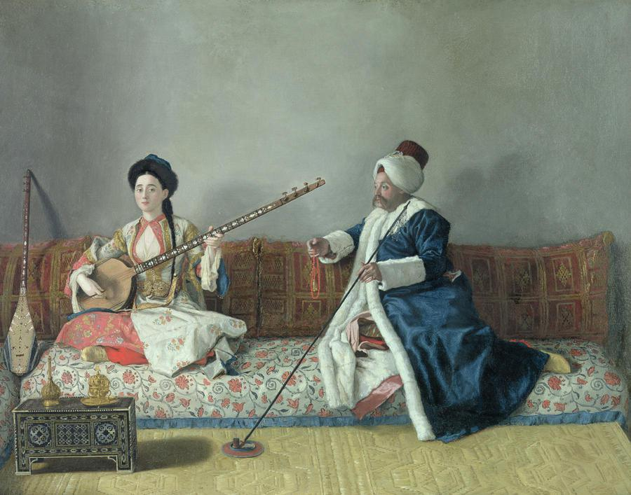
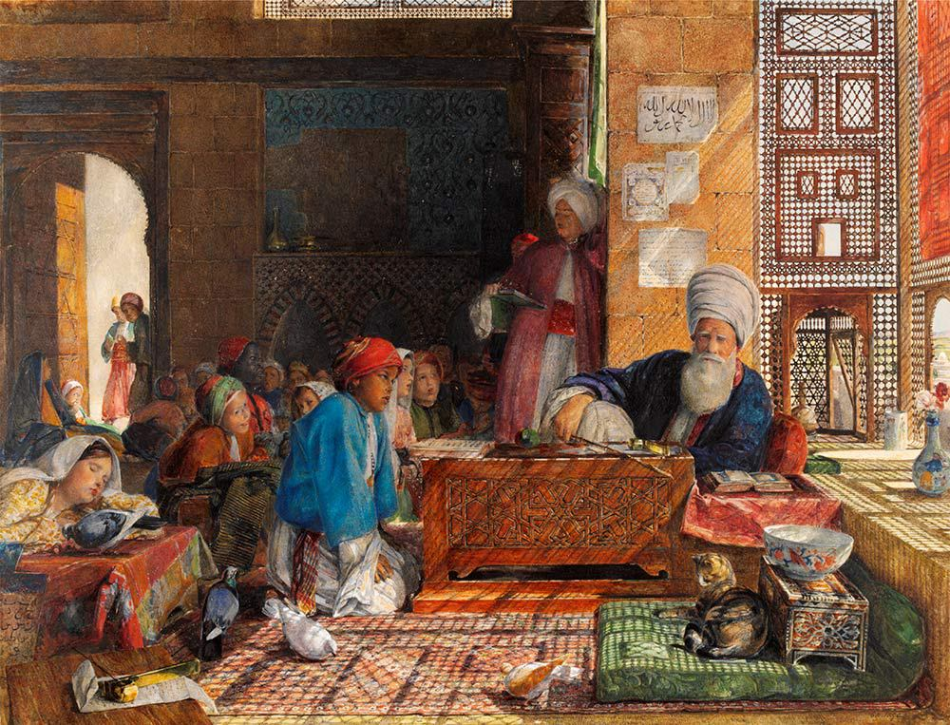
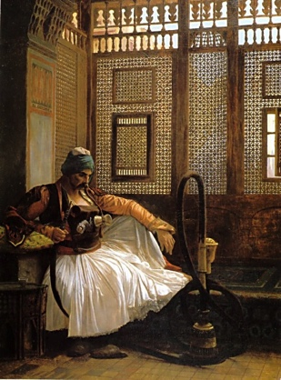
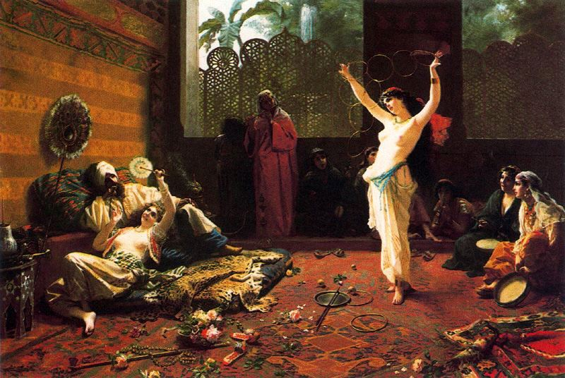
Orientalism

Slide 6
Orientalism: curiosity, fantasy and imperialism
‘Cultural difference’ (admired or otherwise) and the attraction towards the ‘Other’
Orientalism: a discourse that encompasses the non-European world (regardless of the differences within it)
Orientalism: a multidisciplinary tradition (thematic and generic: translation, philology, anthropology, etc.).
Orientalism: a multi-faceted tradition (means different things in different contexts); Orientalisms in the plural
Each Orientalist invents and narrates his/her own Orient; the Orient is a platform of sorts for Orientalist wish-fulfilment

Slide 7
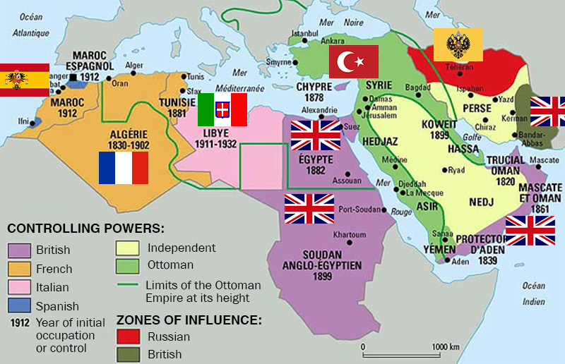
The Arab World in the 19th and Early 20th Centuries
Decline of the Ottoman Empire and European imperial encroachment in the region
Proliferation of Orientalist writing: more Europeans travelled to and wrote about the Arab East

Slide 8
Napoleon’s Occupation of Egypt (1798-1801):
This short encounter triggered Arab awareness of European cultural and scientific achievements; it also set in motion Arab intellectual curiosity westwards
Politically, this was the first European invasion of central Muslim lands since the Crusades.
Militarily, It demonstrated the weakness and decay of the Mamluk-Ottoman system and the once-invincible Muslim armies
Culturally, it put an end to Egypt’s long isolation from the European world and instigated the the Nahda (renaissance/revival) movement in the 19th century

Slide 9
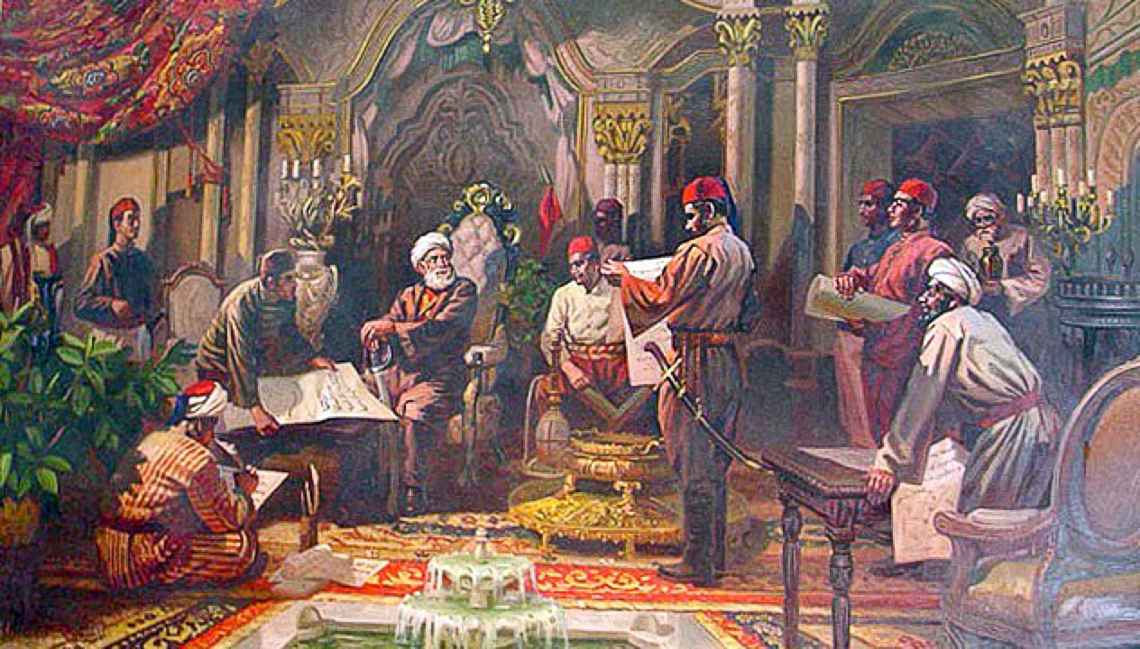
The Euro-Arab Cultural Encounter and the Nahda
Arab scholars ‘rediscovered’ Europe and its cultural worth and aspired to emulate scholarly European achievement
Translations of European works aroused Arab scholars’ interest in modern European ideas (democracy, nationalism, science, philosophy, literature)
‘[…] the works of western orientalists began to be translated into Arabic. […] Thus Arabs not only viewed the West through western eyes but also began to view themselves through those same eyes.’ (Abu-Lughod, p. 76)

Slide 10
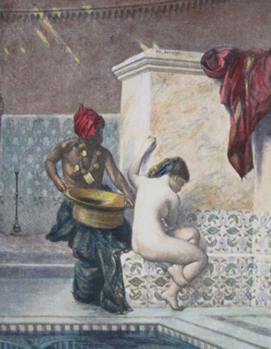
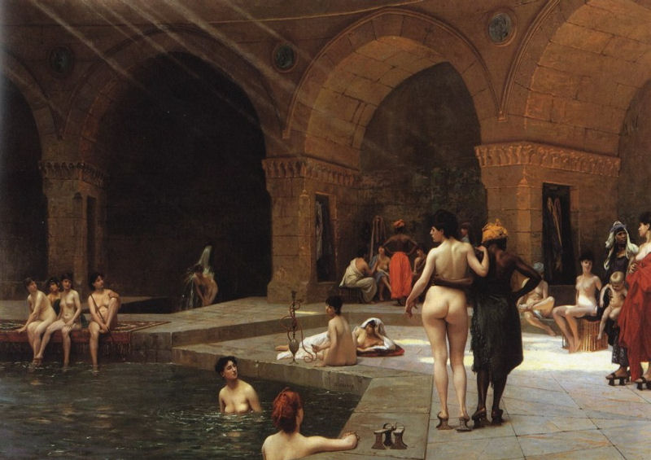
Orientalism and Sexuality
Orientalist art highlights European fantasies about the alleged ‘sexual Otherness’ of the Muslim Orient. In such portrayals, the Muslim East is depicted as a space of ‘sexual licentiousness’.

Slide 11
Orientalist Literature
‘Virtually no European writer who wrote on or travelled to the Orient in the period after 1800 exempted himself or herself from this quest: Flaubert, Nerval, ‘Dirty Dick’ Burton, and Lane are only the most notable. In the twentieth century one thinks of Gide, Conrad, Maugham, and dozens of others.’
‘What they looked for often – correctly, I think – was a different type of sexuality, perhaps more libertine and less guilt-ridden; but even that quest, if repeated by enough people, could (and did become) as regulated and uniform as learning itself.’
‘In time “Oriental sex” was as standard a commodity as any other available in the mass culture, with the result that readers and writers could have it if they wished without necessarily going to the Orient.’ (Said 2003, p. 190)

Slide 12
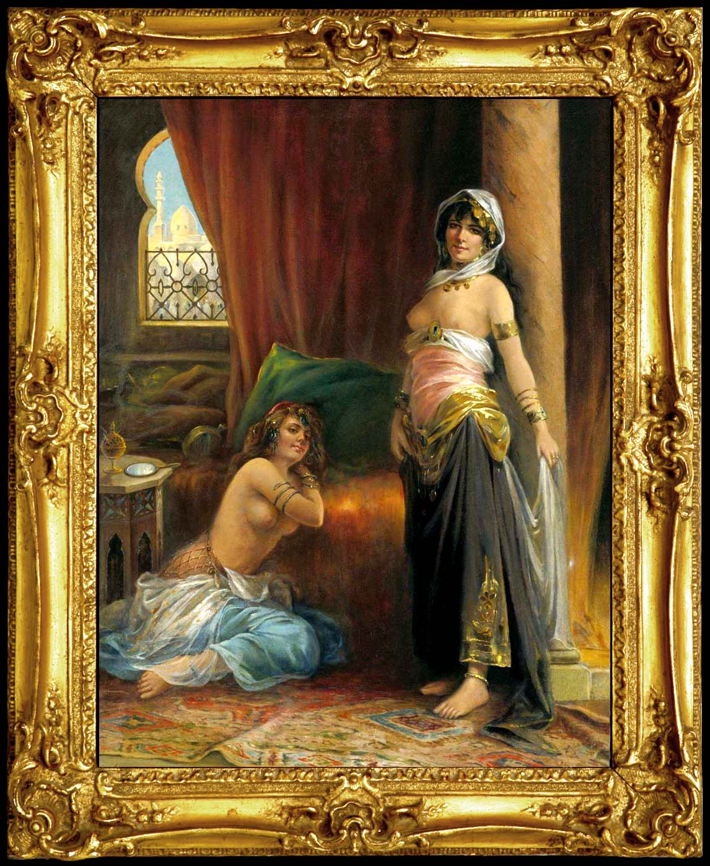
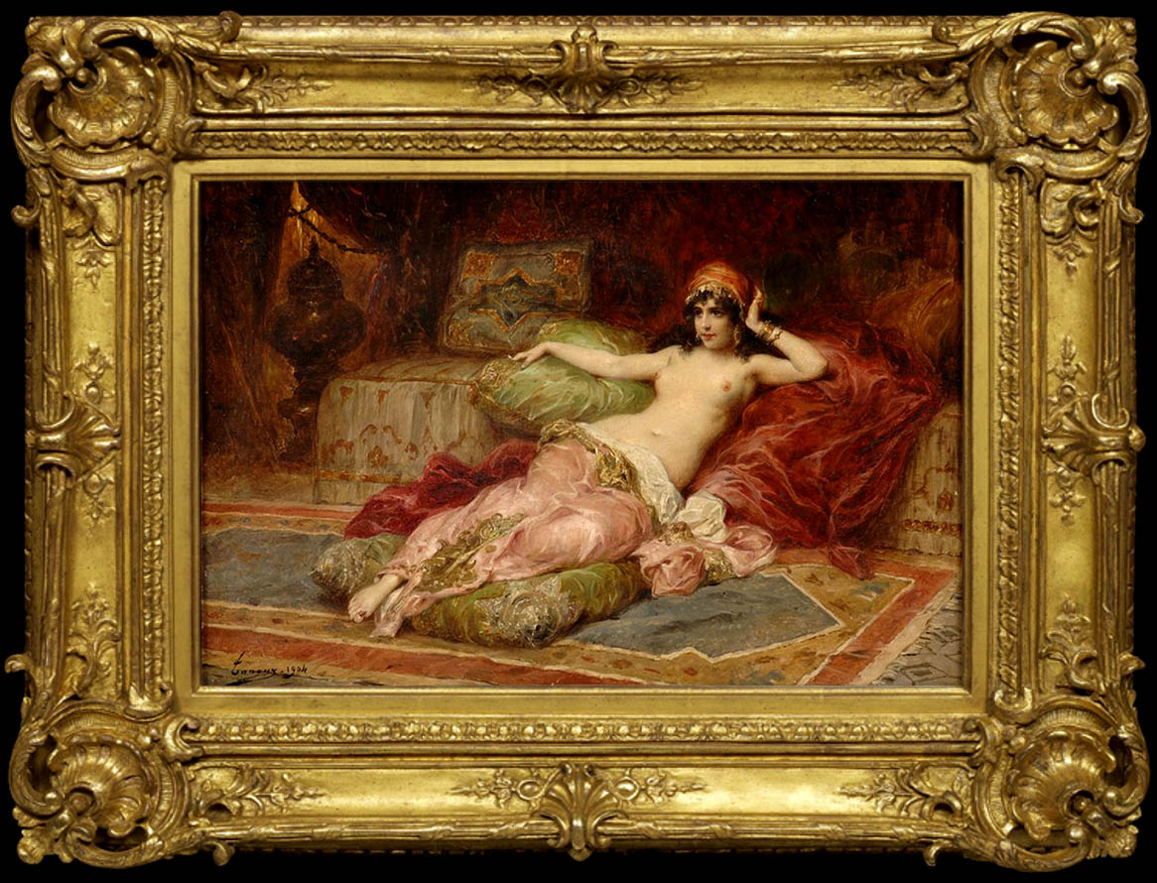
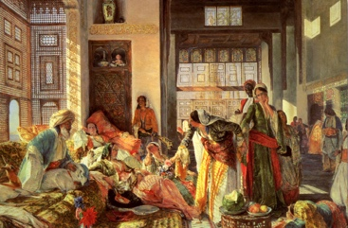

Slide 13
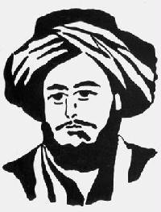
Abd al-Rahman al-Jabarati and French Morals
‘ [French] women do not cover themselves and have no modesty; they do not care whether they uncover their private parts. Whenever a Frenchman has to perform an act of nature he does so wherever he happens to be, even in full view of people, and he goes away as he is, without washing his private parts after defecation. If he is a man of taste and refinement he wipes himself with whatever he finds, even with a paper with writing on it, otherwise he remains as he is. They have intercourse with any women who pleases them and vice versa. Sometimes one of their women goes to a barber’s shop, and invites him to shave her pubic hair. If he wishes he can take his fee in kind.’

Slide 14
‘A different type of sexuality’
Le Charmeur de Serpents (1880) – Jean-Léon Gérôme

Slide 15
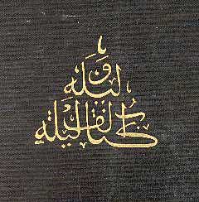
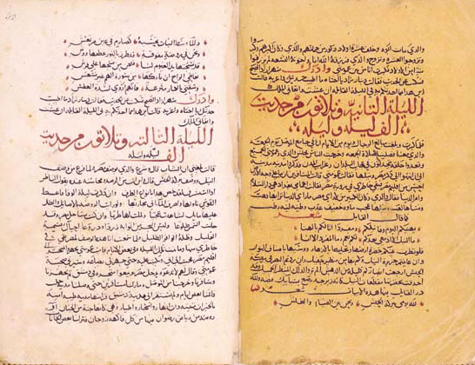
The Arabian Nights

Slide 16
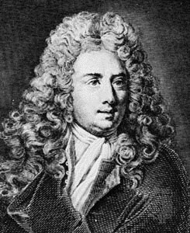
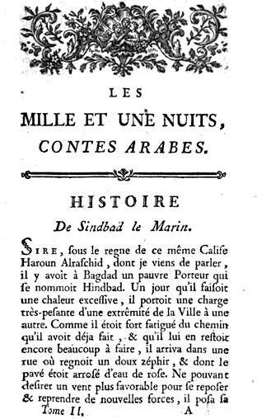
The Arabian Nights in European Translation
The first European translation of the book was Antoine Galland’s French translation (1704-1717)
Other translations were to follow suit soon.
European translators practised self-censorship and edited out the ‘explicitly sexual’ tales
The Oriental classic influenced European literature and ignited Orientalist fantasies (Beckford’s Vathek)
In effect, the tales became synonymous with the ‘charm and magic of the East’ in European consciousness

Slide 17
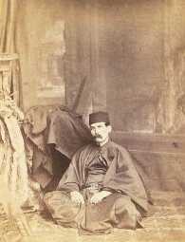
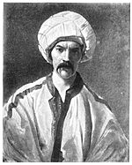
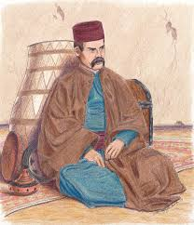
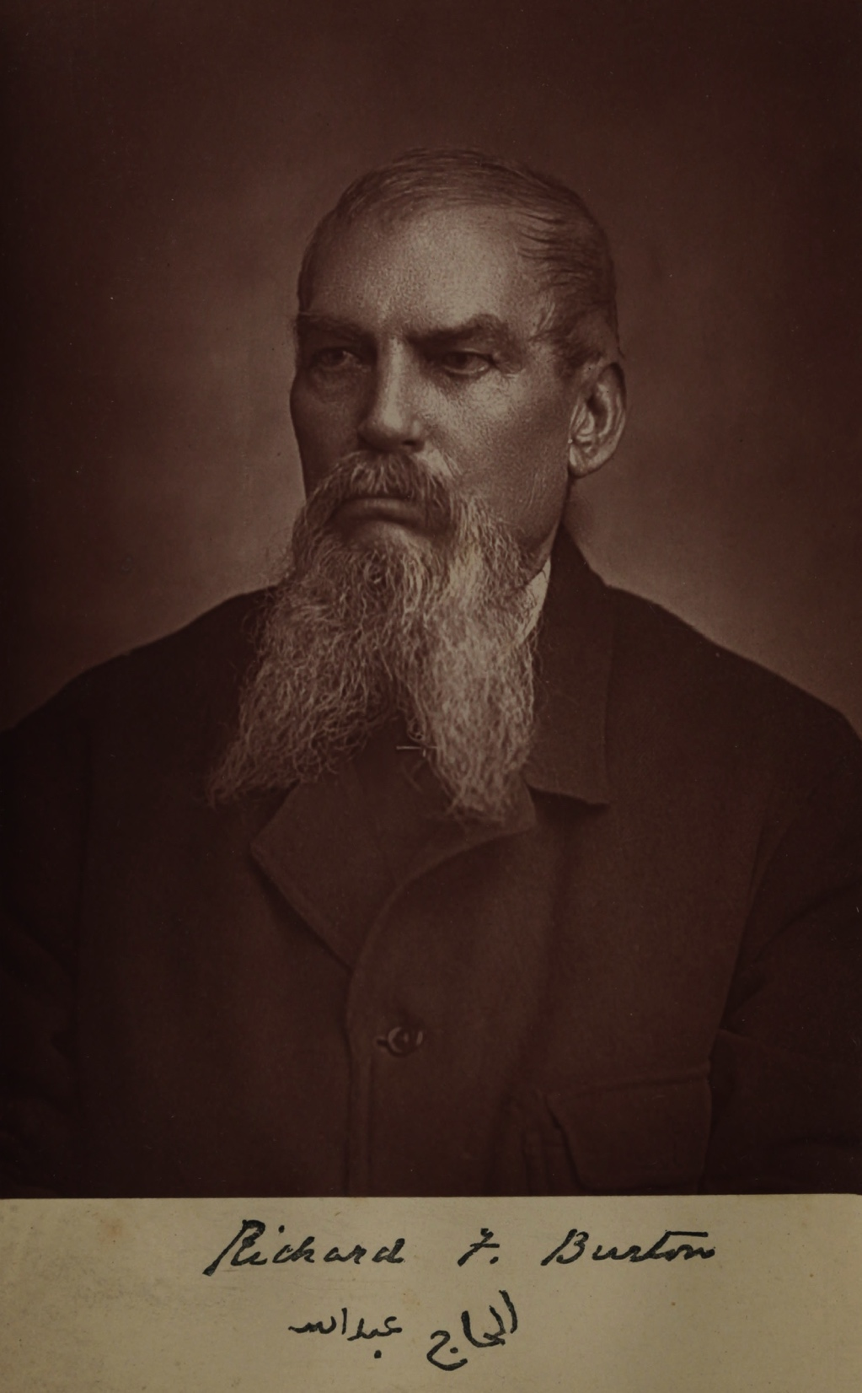
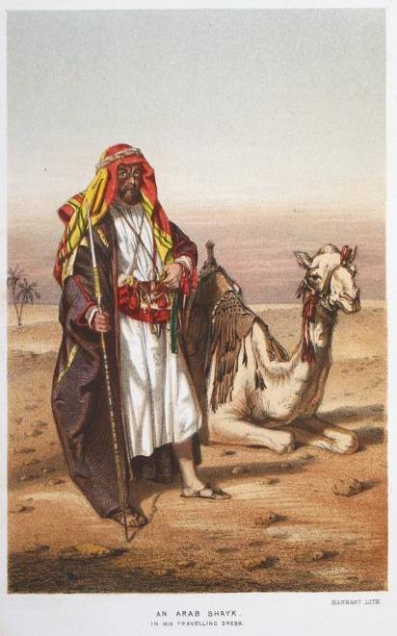
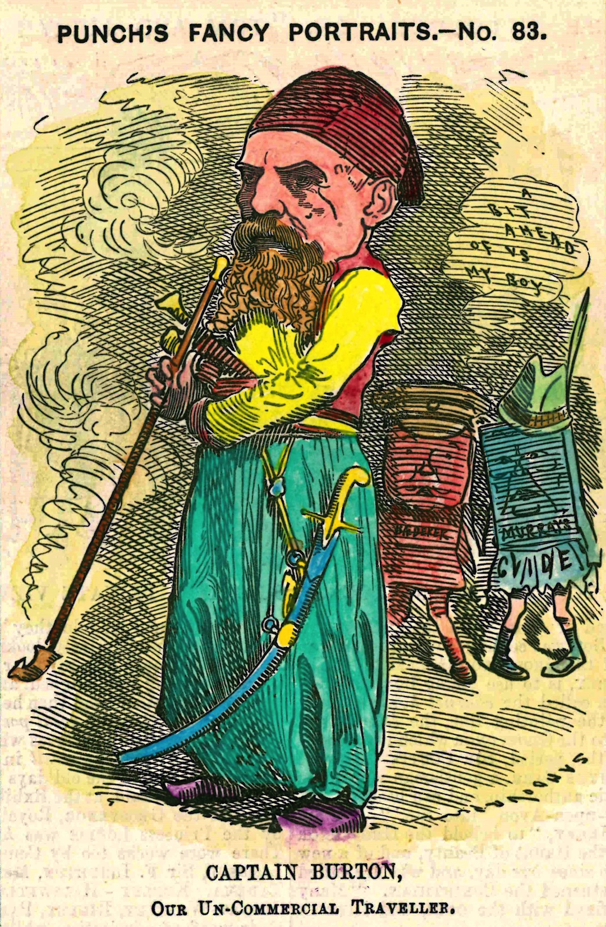
Sir Richard Burton (1921-1890)

Slide 18
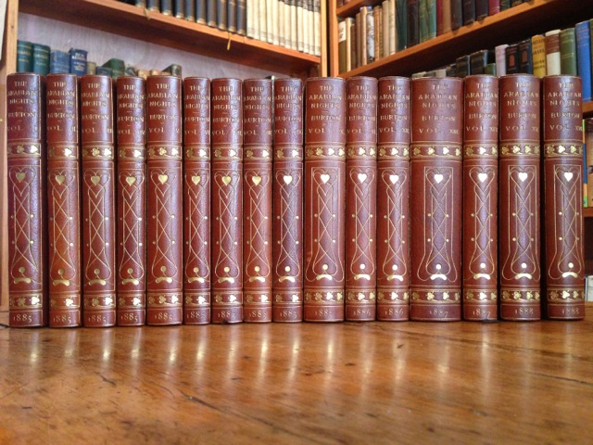
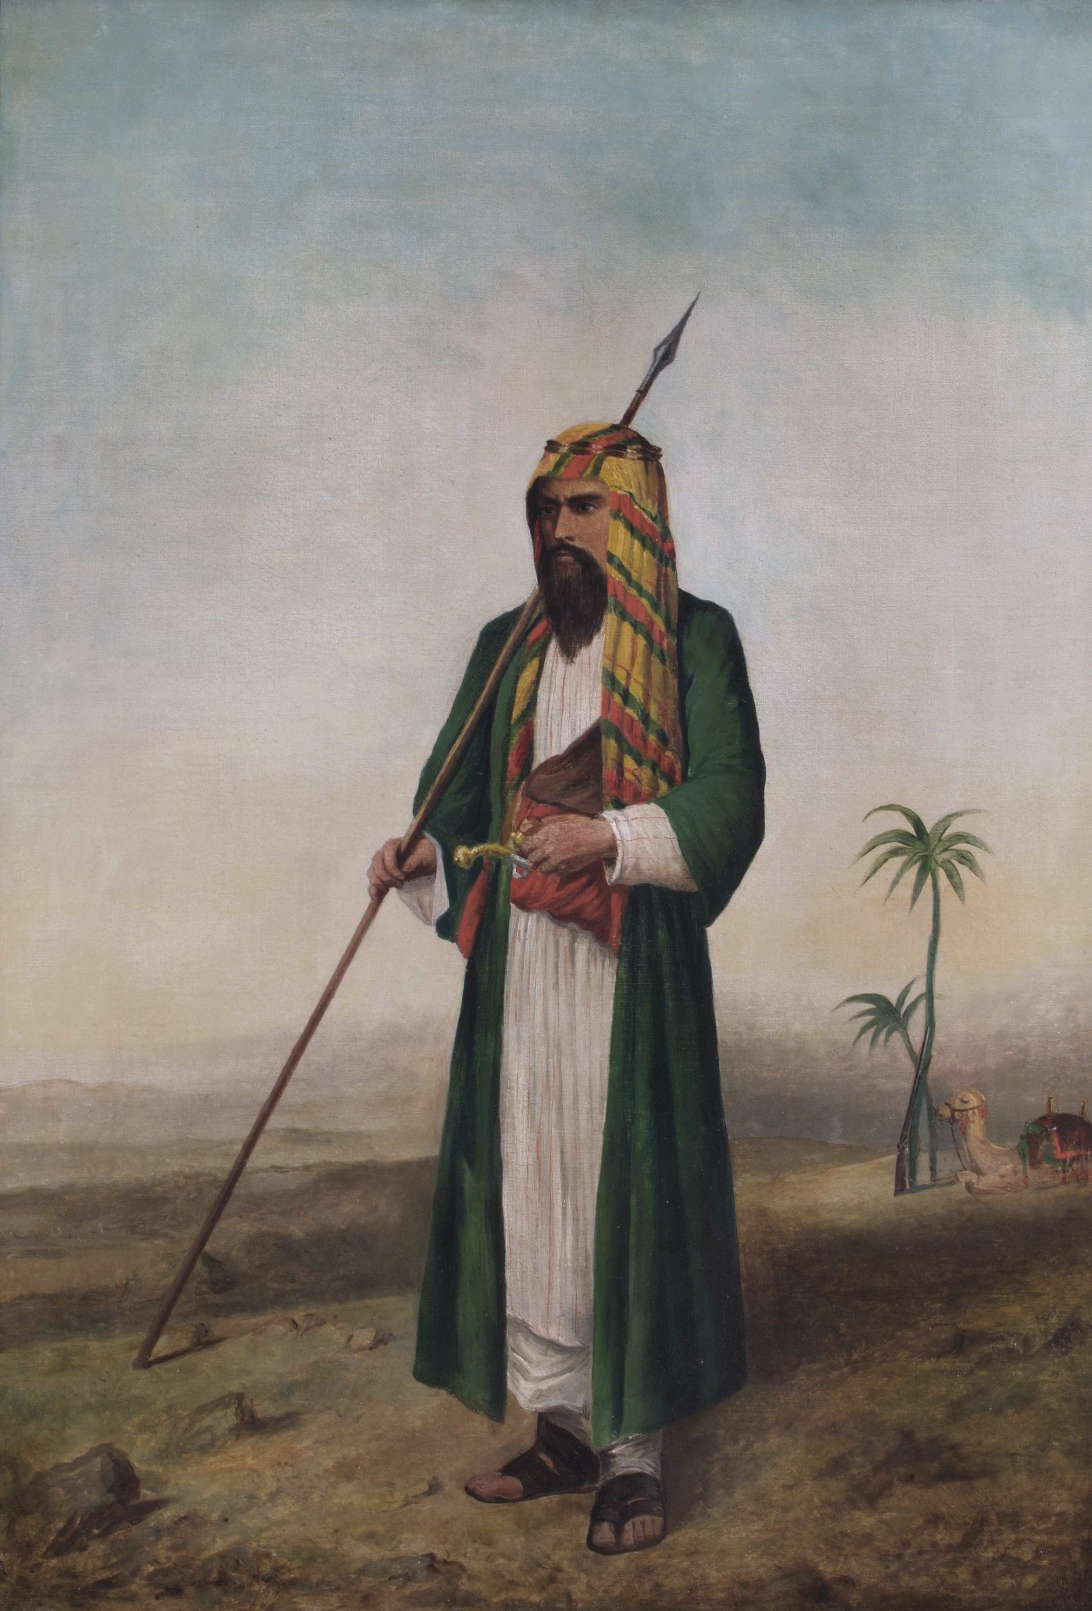
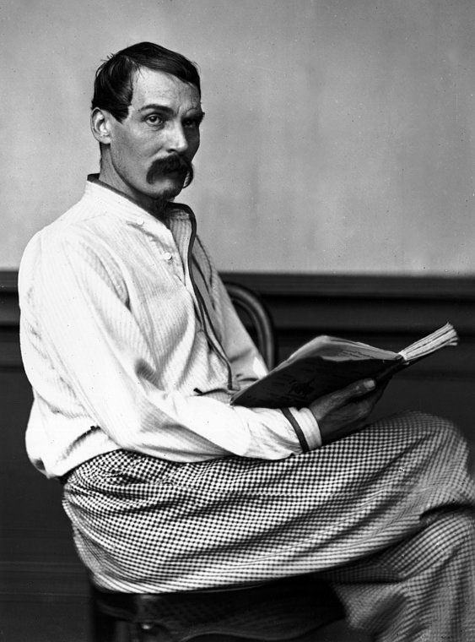
Sir Richard Burton’s ‘Plain & Literal Translation’ (1885-86)
The first to include the entire collection of tales, including the sexually explicit ones
The translation was supplemented by footnotes on ‘Oriental manners’ using the fictional text to support ‘anthropological’ observations i.e. conflating ‘fiction’ with ‘sociology’ and ‘anthropology’
Burton concluded his translation with the ‘Terminal Essay’, in which he developed his theory on the ‘Sotadic Zone’, which links the spread of ‘homosexuality’ to a geographically-determined area, including much of the Arab-Islamic world
Burton’s translation cemented the connection between the Muslim Orient and ‘Other’ illicit forms of sexuality and ‘vice’

Slide 19
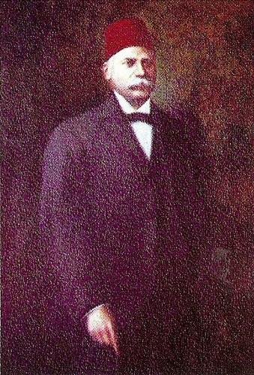
Khalil Sarkis’s Version of The Arabian Nights
While Burton was working on his translation of The Arabian Nights, a new edition of the text in the original Arabic was being produced and published by the Lebanese intellectual, Khalil Sarkis, in 1881-83.
Khalil Sarkis was a Nahda scholar and representative of the class of Levantine intelligentsia.
Sarkis’s version was the first expurgated account of the Arabic classic in the original Arabic.

Slide 20
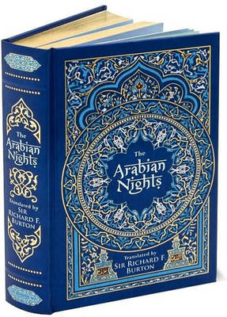
The Book as a Metaphor
When the book was growing ‘thicker’ in Europe (Burton’s complete translation), it was paradoxically shrinking (i.e. being expurgated) in the original Arabic
Sexually explicit tales were being edited out as they came to be regarded as ‘improper’ and ‘morally’ corrupt’ i.e. not in line with European ‘cultivated’ literary taste and manners

Slide 21
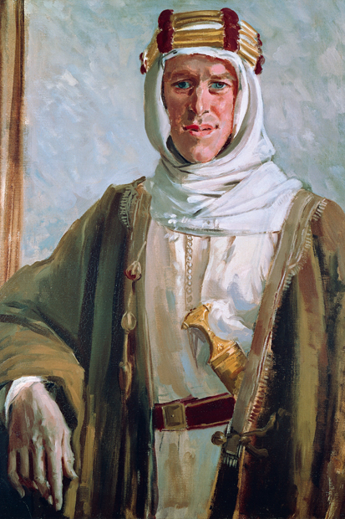
T.E. Lawrence (1888-1935)
A Romantic in the age of modernism
British agent in WWI: he co-led the Arab revolt with Prince Feisal of Mecca
Fantasised about leading a people in their nationalist struggle
But wanted it to be a Romantic episode, involving chivalry
The Arab East became the platform on which he fulfilled his dream

Slide 22
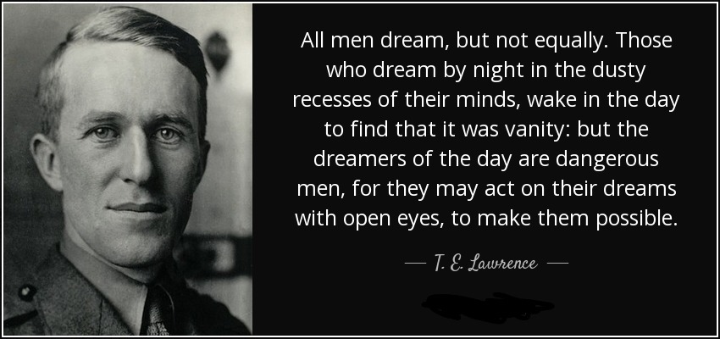
The Orient as a platform of ‘wish fulfilment’

Slide 23
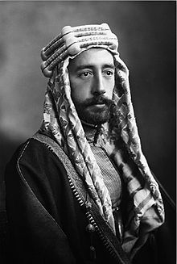
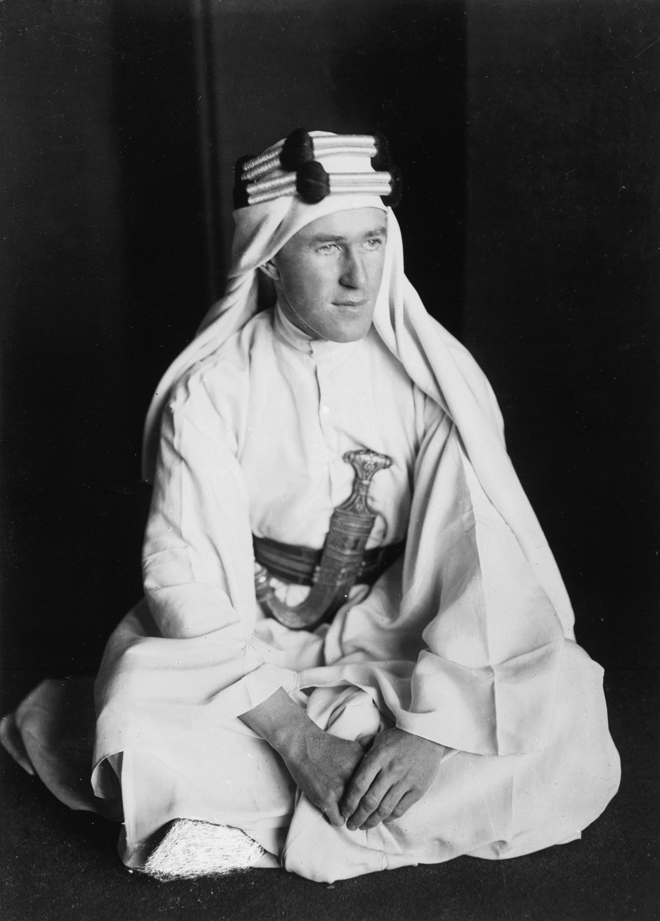
Chivalry, Fantasy and the Homoerotic

Slide 24
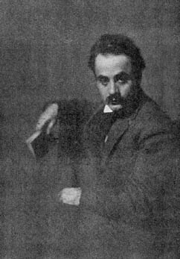
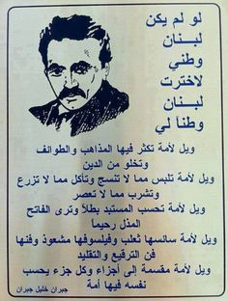
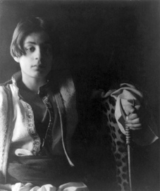
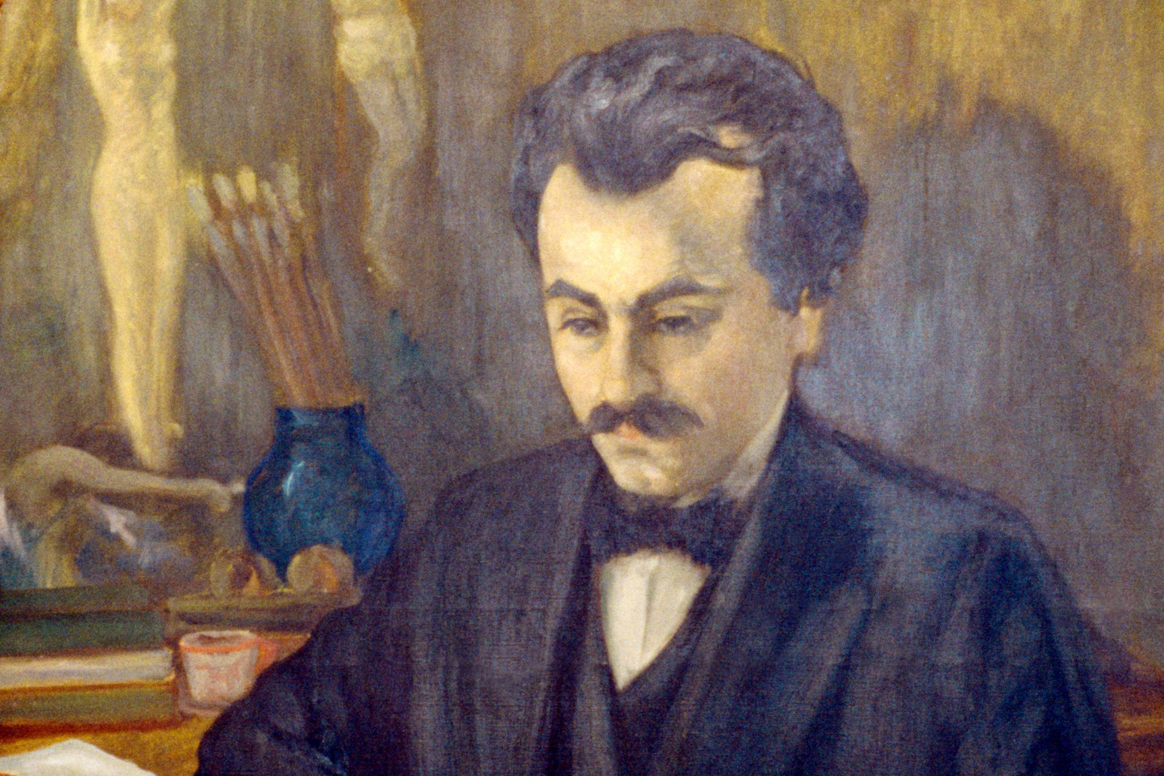
Khalil Gibran (1883-1931)

Slide 25
Gibran’s Bilingual Oeuvre
Gibran produced a combination of 16 works; 8 in English and 8 in Arabic; the most famous of which is The Prophet (1923)
He is often compared to William Blake and other European Romantics:
He capitalised on Orientalist tropes and presented himself as an authentic Oriental
He experimented with literary genres in Arabic and introduced Romanticism into Arabic literature (free verse)
Gibran was a two-way literary conduit: he synthesised Romanticism with Orientalism and styled them differently to his audiences

Slide 26
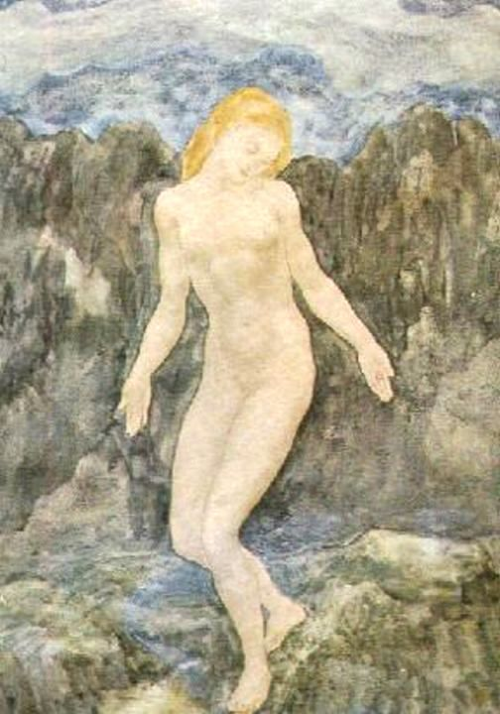
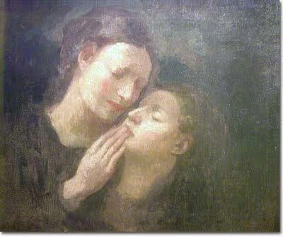
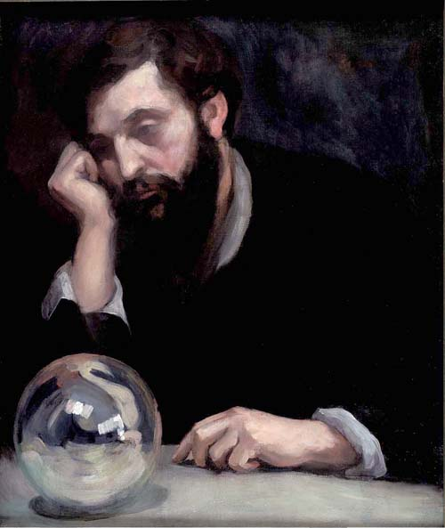
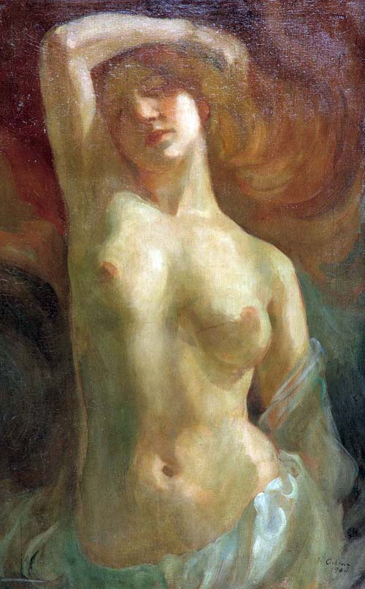
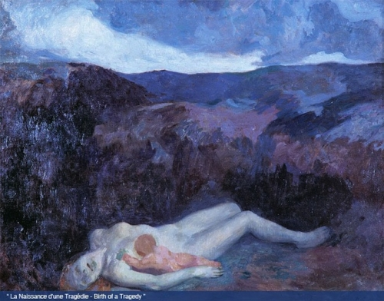
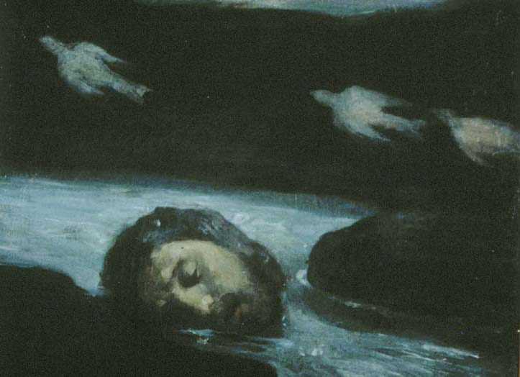
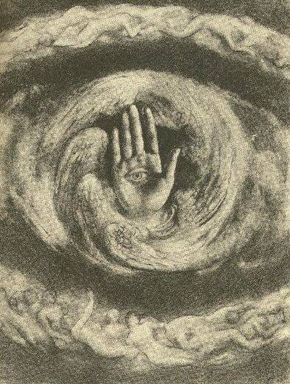
Gibran, the Artist

Slide 27
Culture: Collective Human Enterprise
‘[…] culture is not monolithic […], and is not the exclusive property of East or West, nor of small groups of men or women’ (Said, p. xxvii).
‘Partially because of empire, all cultures are involved in one another; none is single and pure, all are hybrid, heterogeneous, extraordinarily differentiated and unmonolithic’ (Said, p. xxix).
‘Western imperialism and Third World [postcolonial] nationalism feed off each other[…]’: they use ‘culture’ to justify ‘difference’
Contrary to imperialist and nationalist narratives, culture is not a monopoly: it’s a human enterprise.
Transcultural writing is a dynamic, two-way process; it is the platform upon which our collective human culture is created and transmitted

Slide 28
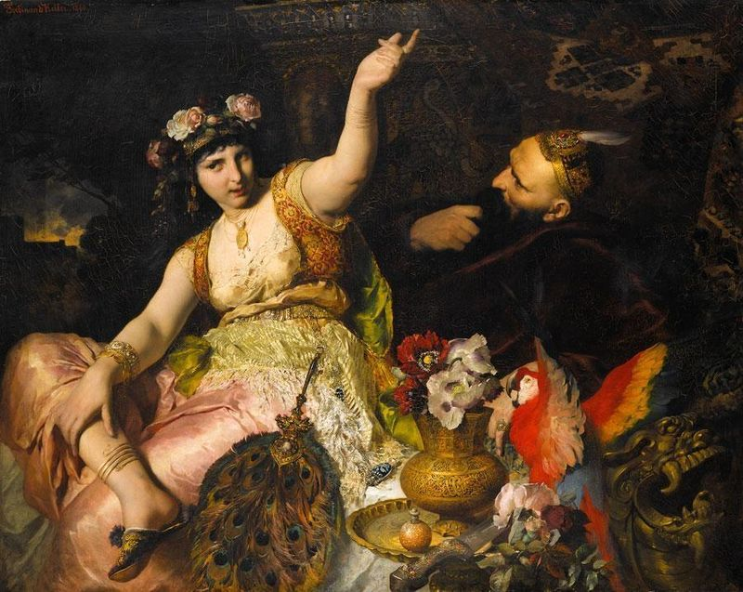
The Arabian Nights: 1001 Nights
A collection of medieval folkloric tales from the Middle East, North Africa, Persia, India and China
Antoine Galland was the first European to translate the book (into French)
The tales proved sensational and inspirational in Europe
Some tales were ‘added’ to the original manuscript by European writers

Slide 29
