Slide 1
Linguistic observations of social change: Lesbian identities in New Zealand Lavender Langauges 26 – Göteborg, 2-5 May 2019
Evan Hazenberg, University of Sussex
E.Hazenberg@sussex.ac.uk

Slide 2
Introduction: Sexuality in sociophonetics
sociophonetics → productive level of linguistic system for identity work
focus most often on gay men
accessible stereotypes men > women?
‘authentic lesbian voice’ (Moonwomon-Baird 1997)
gay men construct identity in opposition to heteronormative masculinity, but lesbians construct identity through affiliation with women (Zwicky 1997; Cameron 2011)
so why expect women to ‘do’ identity the way men do?
Queen 2014: other-oriented tensions can/do exist between groups of women, but still no coherent stereotypes of ‘sounding lesbian’

Slide 3
Introduction: Sexuality in sociophonetics
BUT: some women do ‘sound lesbian’
intonation and pitch variability?
findings inconsistent (Waksler 2001; Van Borsel et al. 2013)
some differences at the level of vowels (Pierrehumbert et al. 2004)
generally patterns are not very clear
ditto for studies of ‘gay voice’ → cluster of features, not one single [±feature]
we process a lot of social information that is below the radar (i.e. not a stereotype)
hard to know what to look for, but it’s probably there → cast a wide net

Slide 4
New Zealand
NZ traditionally seen as a very conservative country: homosexuality illegal until 1986
laws written targeting gay men, but lesbians often caught in the crossfire
organised efforts at law reform since 1960s but no traction until the 1980s (Laurie & Evans 2009; Evans, Laurie & Instone 2009)
lesbian involvement contested within community → solidarity vs. (in)visibility vs. safety
by mid-1980s: lesbians visible enough in public eye that awareness of identity takes hold
opportunity for tensions between straight and lesbian women that parallels those between gay and straight men

Slide 5
New Zealand
1986
July 9: Homosexual Law Reform Bill passed in Parliament
July 11: Homosexual Law Reform Act signed into law
August 8: HLRA came into effect
August 9: world didn’t end
2004
Civil Union Act 2004
2013
Marriage (Definition of Marriage) Amendment Act 2013

Slide 6
New Zealand
so what does this mean?
two ‘generations’ of queer women in NZ
50+ = came of age before decriminalisation
identity as lesbians overtly political stance
strong affiliation with LGB/queer community
social distancing between straight and lesbian women
under 30 = came of age with more societal acceptance of gender/sexual diversity
identity as a (minor?) dimension of identity
much looser affiliation with queer community
no particular distancing from/by straight women

Slide 7
This project
 | queer women | straight women | trans women | queer men | straight men | trans men | total
older | 4 | 5 | 3 | 5 | 4 |  | 21
younger | 4 | 5 | 2 | 5 | 4 | 5 | 25
total | 8 | 10 | 5 | 10 | 8 | 5 | 46
data collected 2013-2015 in Auckland
participants generally demographically comparable (except for younger trans women)
participants within gendered groups generally knew each other
‘doing’ comparable identities

Slide 8
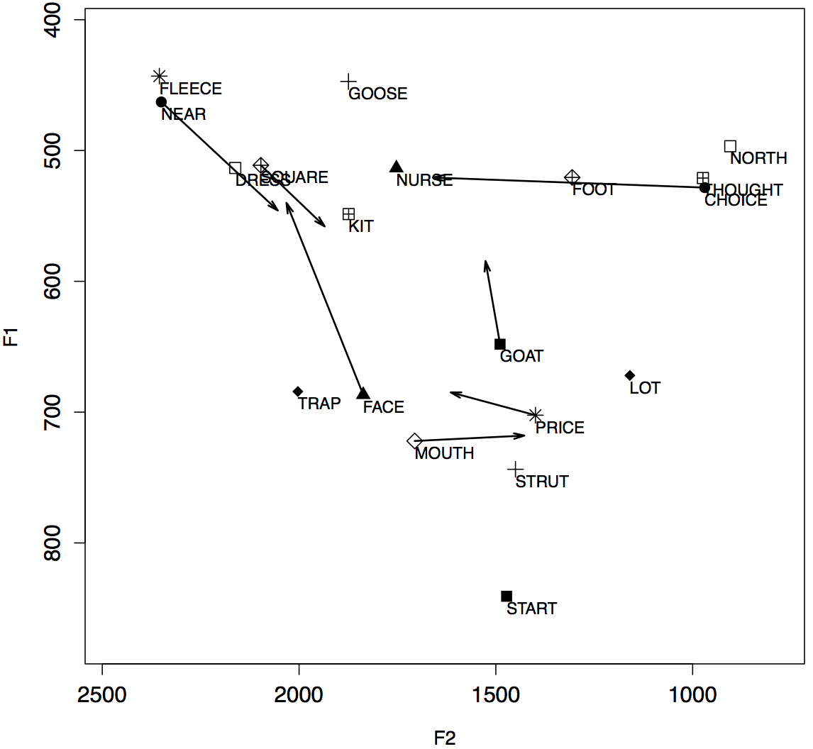
NZE vowels

Slide 9
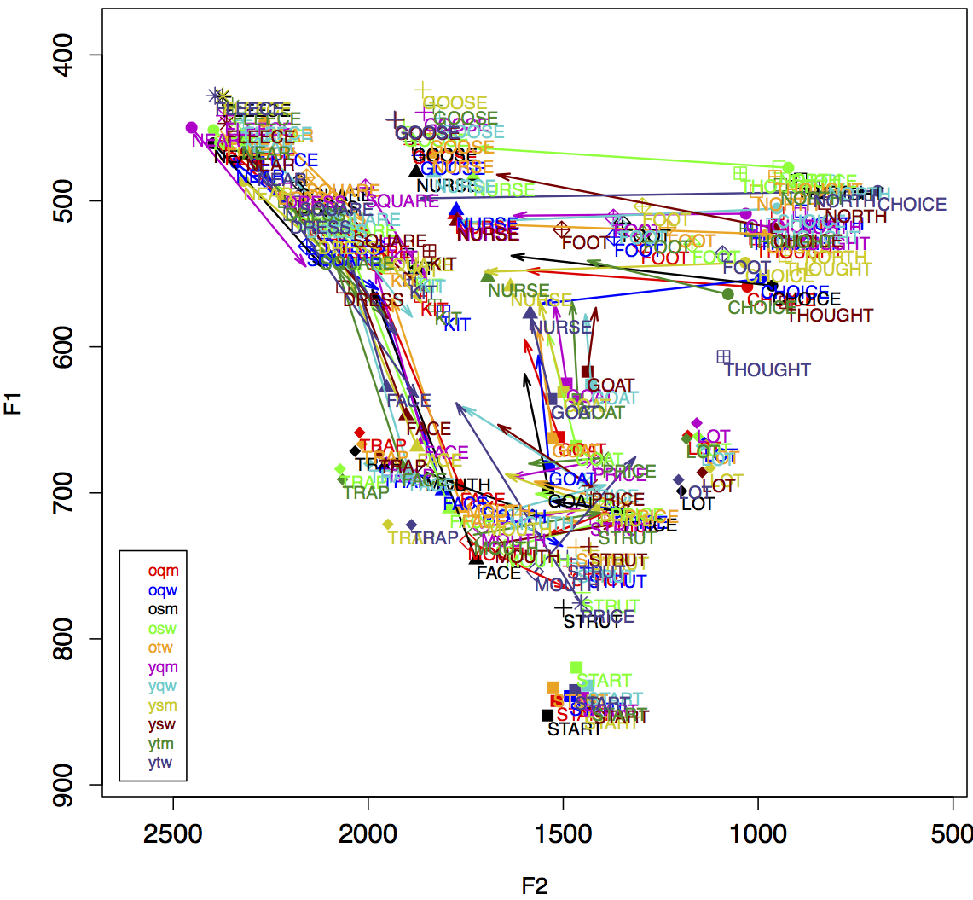
NZE vowels
FOOT
DRESS
TRAP

Slide 10
NZE vowels
NZE vowels undergoing change(s)
Labovian sound change – gender relevant
FOOT
has been fronting for some time (Bauer & Warren 2004; Warren 2004)
DRESS and TRAP
involved in a push chain (e.g. Langstrof 2006; Maclagan & Hay 2004; Gordon et al. 2004)
but not stigmatized (Maclagan et al. 1999)

Slide 11
Vowels
vowels automatically extracted and measured using FAVE (Rosenfelder et al. 2011)
Lobanov-normalized within FAVE
multivariate analysis – Rbrul (Johnson 2009)
not overestimate social factors
ran with single, paired, and three-way interactions of social factors
age (o/y)
identity (q/s/t)
gender (m/w)

Slide 12
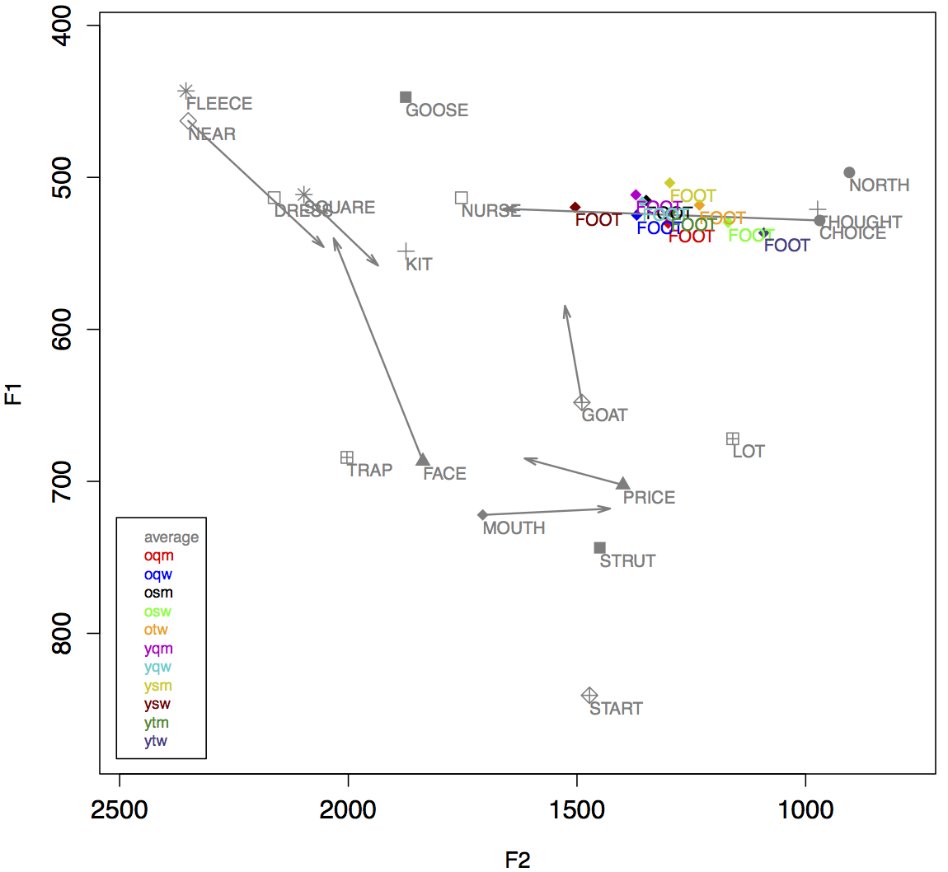
FOOT
Table 1: Multivariate analysis of FOOT [F2] (social factors only) - organised by age
Younger speakers | Coef | Mean | Older speakers | Coef | Mean
ytw | -133.357 | 1091 | osw | -91.988 | 1169
ysm | -9.545 | 1297 | otw | -80.088 | 1232
ytm | 13.320 | 1295 | oqm | -39.740 | 1301
yqm | 74.081 | 1371 | osm | 9.368 | 1349
yqw | 79.097 | 1358 | oqw | 34.133 | 1369
ysw | 144.719 | 1504
Range | 278.076 |  | Range | 126.121
Range overall: 278.076 |  |  | Sig. p=0.015
Also retained as significant in model: - Following segment (p<0.001)

Slide 13
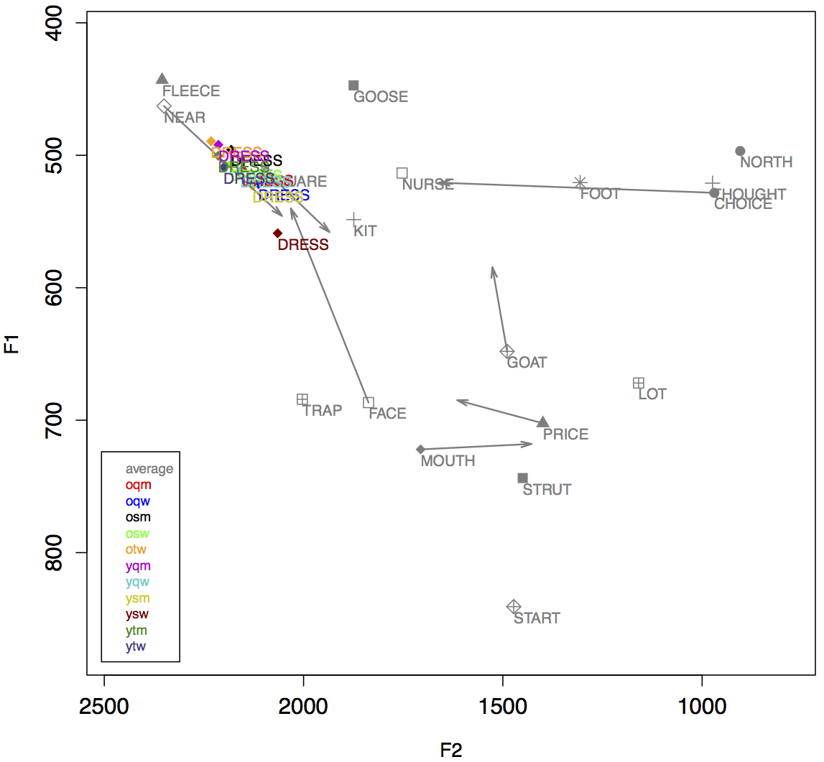
DRESS
Table 2: Multivariate analysis of DRESS [ED] (social factors only), organised by age
Younger speakers | Coef | Mean | Older speakers | Coef | Mean
ytm | -43.131 | 218 | osw | -51.208 | 255
ytw | -34.933 | 245 | otw | -45.871 | 213
yqm | 8.004 | 271 | osm | -39.743 | 234
ysm | 19.976 | 290 | oqm | 27.763 | 309
yqw | 31.536 | 305 | oqw | 42.235 | 309
ysw | 85.552 | 377
Range | 128.683 |  | Range | 93.443
Range overall: 136.760 |  |  | Sig. p=0.006
Also retained as significant in model: - Following segment (p<0.001) - Preceding segment (p<0.001)

Slide 14
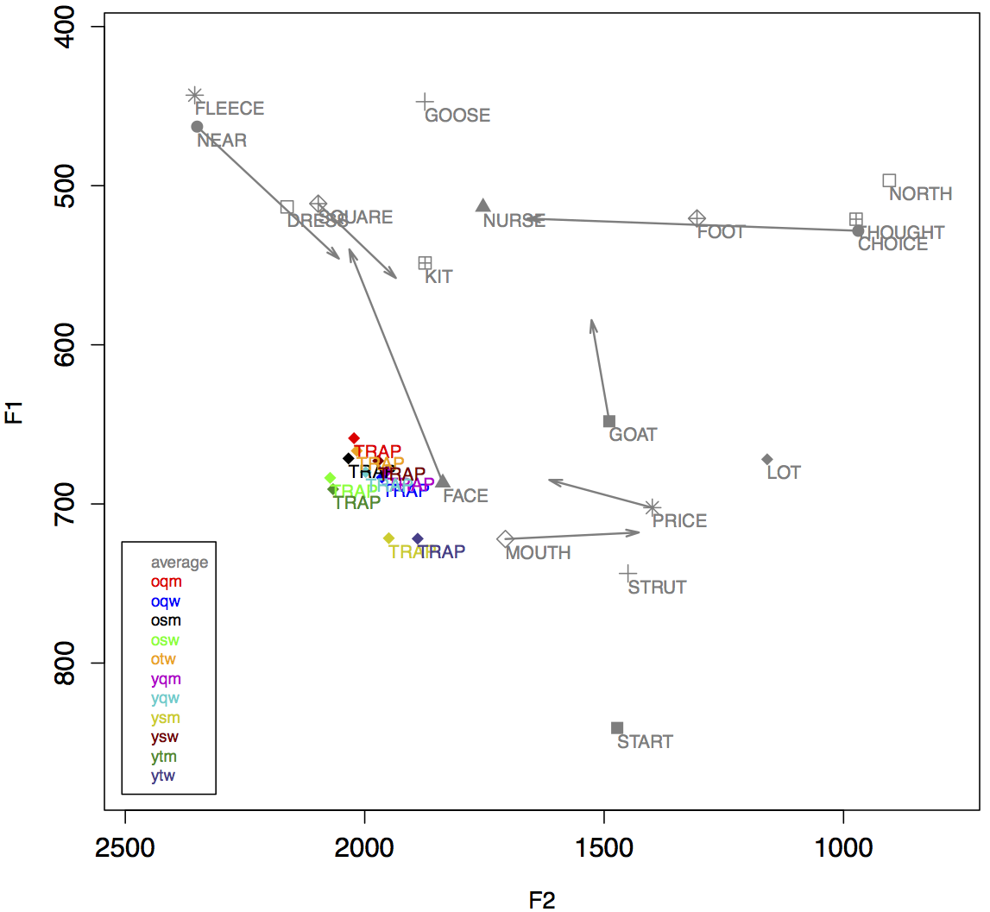
TRAP
Table 3: Multivariate analysis of TRAP [ED] (social factors only) - organised by age
Younger speakers | Coef | Mean | Older speakers | Coef | Mean
ytm | 53.279 | 617 | osw | 73.971 | 627
yqw | 2.175 | 558 | oqm | 47.819 | 586
ysw | -8.369 | 536 | osm | 29.205 | 591
yqm | -44.269 | 514 | otw | 17.472 | 577
ysm | -50.864 | 499 | oqw | -25.559 | 530
ytw | -94.861 | 441
Range | 148.14 |  | Range | 99.530
Range overall: 168.832 |  |  | Sig. p=0.015
Also retained as significant in model: - Preceding segment (p<0.001) - Following segment (p<0.001)

Slide 15
Vowels
Table 4: Index of Similarity for NZE Vowel Space
 | ytw | ytm | ysw | ysm | yqw | yqm | otw | osw | osm | oqw
oqm | 4 | 5 | 6 | 6 | 8 | 4 | 8 | 9 | 5 | 10
oqw | 3 | 4 | 7 | 7 | 7 | 5 | 7 | 7 | 4
osm | 2 | 3 | 3 | 4 | 5 | 4 | 6 | 5
osw | 5 | 5 | 4 | 6 | 5 | 3 | 7
otw | 5 | 5 | 4 | 5 | 8 | 7 |  |  |  | Legend
yqm | 3 | 7 | 6 | 7 | 9 |  |  |  |  | 1-2
yqw | 6 | 5 | 9 | 8 |  |  |  |  |  | 3-4
ysm | 6 | 7 | 7 |  |  |  |  |  |  | 5-6
ysw | 3 | 6 |  |  |  |  |  |  |  | 7-8
ytm | 4 |  |  |  |  |  |  |  |  | 9-10

Slide 16
The story so far
women generally have very similar vowel spaces within their age groups
differences between age groups – to be expected with a system undergoing change
but there are three under-the-radar vowels that do show a difference in the older cohort
women maximally differentiated by sexuality
ANAE: small differences in otherwise similar systems can carry a lot of social meaning (Labov et al. 2006)
these differences neutralised within younger cohort

Slide 17
Why?
social distance: who’s retreating from whom?
are older straight women distancing themselves from their lesbian peers, or vice versa?
linguistic considerations
older lesbians are closer in vowel realisation to the younger groups – older straight women more ‘conservative’
social considerations
generational difference in the centrality of sexuality to overall identity
younger – doesn’t matter
older – political stance with social consequences

Slide 18
The big(ger) picture
sociophonetics and feminine sexuality
women can encode social information about sexuality/community using the same mechanisms that men do
harder to identify the linguistic forms when they’re below conscious awareness → harder to stereotype socially → harder to know where to start looking
we need to rethink how we approach the linguistics of women’s sexuality
social focus on men means a lot of variation among women is going to be ‘invisible’
big-data methods mean we can see below-the-radar patterns

Slide 19
The big(ger) picture
sociophonetics and social change
when social changes move through a community rapidly, there can be equally rapid linguistic change
new forms > old forms
associations of form-meaning shift
study of language variation can shed new light on these social changes
not only sexuality, but anything where there is a disruption to social structures and schema

Slide 20
Thank you! …any questions?
Bauer, Laurie & Paul Warren. 2004. New Zealand English: Phonology. In B Kortmann, EW Schneider, Kate Burridge, R Mesthrie & C Upton (eds.), A Handbook of Varieties of English: A Multimedia Reference Tool, volume 1. Berlin: Mouton de Gruyter. 580-602.
Cameron, Deborah. 2011. Sociophonetics and sexuality: Discussion. American Speech 86(1): 98-103.
Evans, Linda, Alison Laurie & Tighe Instone. 2009. New Zealand homosexual law reform 1984-1986 selected chronology. In Laurie & Evans (eds.), Twenty Years On: Histories of Homosexual Law Reform in New Zealand, pp.99-102. Wellington, NZ: LAGANZ.
Gordon, Elizabeth, Lyle Campbell, Jennifer Hay, Margaret Maclagan, Andrea Sudbury & Peter Trudgill. 2004. New Zealand English: Its origins and evolution. Cambridge, UK: Cambridge University Press.
Johnson, Daniel Ezra. 2009. Getting off the Goldvarb standard: Introducing Rbrul for mixed-effects variable rule analysis. Language and Linguistics Compass, 3(1): 359-383.
Kennedy, Marianna. 2006. Variation in the pronunciation of English by New Zealand school children. Unpublished MA thesis. Victoria University of Wellington: Wellington, NZ.
Labov, William, Sharon Ash & Charles Boberg. 2006. Atlas of North American English: Phonetics, Phonology and Sound Change. Berlin & New York: Mouton de Gruyter.
Langstrof, Christian. 2006. Vowel change in New Zealand English - Patterns and implications. PhD Thesis. University of Canterbury: Christchurch, NZ.
Laurie, Alison J & Linda Evans. 2009. Legislating homosexuality. In Laurie & Evans (eds.), Twenty Years On: Histories of Homosexual Law Reform in New Zealand, pp.95-97. Wellington, NZ: LAGANZ.
Maclagan, Margaret & Jen Hay (2004). The rise and rise of New Zealand English DRESS. Proceedings of the 10th Australian International Conference on Speech Science & Technology. Macquarie University, Sydney: 8-10 December. 183-188.
Maclagan, Margaret, Elizabeth Gordon & Gillian Lewis. 1999. Women and sound change: Conservative and innovative behavior by the same speakers. Language Variation and Change, 11: 19-41.
Moonwomon-Baird, Birch. 1997. Toward the study of lesbian speech. In Anna Livia & Kira Hall (eds), Queerly Phrased: Language, Gender, and Sexuality. Oxford: Oxford University Press. 202-213.
Pierrehumbert, Janet B, Tessa Bent, Benjamin Munson, Anne R Bradlow & J Michael Bailey. 2004. The influence of sexual orientation on vowel production. Journal of the Acoustical Society of America, 116(4): 1905-1908.
Queen, Robin. 2014. Language and sexual identities. In Susan Ehrlich, Miriam Meyerhoff & Janet Holmes (eds.), The Handbook of Language, Gender, and Sexuality. Oxford: Wiley Blackwell. 203-219.
Rosenfelder, Ingrid, Joe Fruehwald, Keelan Evanini & Jiahong Yuan. 2011. FAVE (Forced Alignment and Vowel Extraction) Program Suite. http://fave.ling.upenn.edu
Van Borsel, John, Jana Vandaele & Paul Corthals. 2013. Pitch and pitch variation in lesbian women. Journal of Voice, 27(5): 656.e13-656.e16.
Waksler, Rachelle. 2001. Pitch range and women’s sexual orientation. Word, 52(1): 69-77.
Warren, Paul (2004). On the front foot: the quality and quantity of ANZE vowels. Paper presented at PW PANZE, Sydney: December 8.
Zwicky, Arnold M. 1997. Two lavender issues for linguistics. In Anna Livia & Kira Hall (eds.), Queerly Phrased: Language, Gender, and Sexuality. Oxford: Oxford University Press. 21-34.
E.Hazenberg@sussex.ac.uk

